Slide 1
The National Association of SARA Title III Program Officials (NASTTPO)
April 17,2023
1:00PM – 4:00 PM
Len Wallace
US EPA Region 1 New England
Emergency Planning and Community Right-to-Know Act (EPCRA) and how it’s changing

Slide 2
DISCLAIMER
The information presented in this PowerPoints intended solely to help parties understand the obligations and requirements imposed by Emergency Planning and Community Right-to-Know Act (EPCRA) . This presentation does not constitute EPA policy. Mention of trade names or commercial products does not constitute endorsement or recommendation of use.
Links to non-EPA websites are provided solely as a pointer to information that might be useful to the public and do not imply any official EPA endorsement of or a responsibility for the opinions, ideas, data or products presented at those locations or guarantee the validity of the information provided.

Slide 3
Emergency Planning and Community Right-to-Know Act (EPCRA)
Emergency Planning and Community Right-to-Know Act (EPCRA)
October 17, 1986
Congress amended the Comprehensive Environmental Response, Compensation, and Liability Act (CERCLA) in 1986 with the enactment of the Superfund Amendments and Reauthorization Act (SARA).

Slide 4
EPCRA Overview
SECTION | COVERAGE/ TOPIC | REQUIREMENT | RELEVANT CHEMICAL LIST | THRESHOLDS | SUBMIT TO:
301-303 | Emergency Planning | LEPC/TEPC Emergency Plan, EHS Notification | 356 Extremely Hazardous Substance | Specified Threshold Planning Quantities (TPQ: 1 - 10,000 #) | SERC/TERC LEPC/TEPC EPA
304 | Emergency Notification | Accidental Release Reporting | EHS and CERCLA 102(a) Substance | Specified Reportable Quantities | SERC/TERC LEPC/TEPC NRC
311 | Hazardous Chemical Inventory | SDS (MSDS) or List of Chemicals | OSHA Hazardous Chemicals (No Specific List) | 10,000 #, or, if EHS, 500 #, or TPQ - whichever is lower | SERC/TERC LEPC/TEPC Local Fire Dept
312 | Hazardous Chemical Inventory | Inventories, Hazards, and Locations (Tier I and II) | OSHA Hazardous Chemicals (No Specific List) | 10,000 #, or, if EHS, 500 #, or TPQ - whichever is lower | SERC/TERC LEPC/TEPC Local Fire Dept
313 | Toxic Chemical Release Reporting | Total Annual Release, Waste Management, & Source Reduction Data - PPA (Form R) | Over 600 Toxic Chemicals and Chemical Categories | 25,000 # manufactured or processed; 10,000 # otherwise used | EPA State
Executive Order 13834 of May 17, 2018

Slide 5
EPCRA Section 301 11001.Establishment of State commissions, planning districts, and local committees.

Slide 6
EPCRA Section 301 11001.Establishment of State commissions, planning districts, and local committees.
“the State emergency response commission who have technical expertise in the emergency response field.
The State emergency response commission shall appoint local emergency planning committees under subsection (c) of this section and shall supervise and coordinate the activities of such committees.”

Slide 7
EPCRA Section 301 11001.Establishment of State commissions, planning districts, and local committees.
The State emergency response commission shall establish procedures for receiving and processing requests from the public for information under section 11044 of this title, including tier II information under section 11022 of this title.
Such procedures shall include the designation of an official to serve as coordinator for information.

Slide 8
EPCRA Section 301 11001.Establishment of State commissions, planning districts, and local committees.
the State emergency response commission shall appoint members of a local emergency planning committee for each emergency planning district.
Each committee shall include, at a minimum, representatives from each of the following groups or organizations: elected State and local officials; law enforcement, civil defense, firefighting, first aid, health, local environmental, hospital, and transportation personnel; broadcast and print media; community groups; and owners and operators of facilities subject to the requirements of this subchapter.

Slide 9
The National Governors Association (NGA)

Slide 10
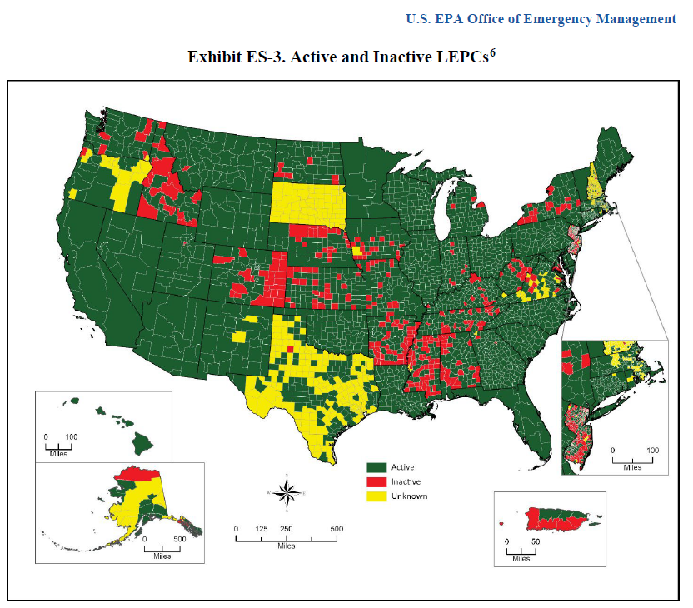

Slide 11
Chemicals in Your Community Guides
September 15, 1988
Chemicals In Your Community: A Guide to EPCRA
September 1989
When All Fails: Enforcement of EPCRA - A Self Help Manual for LEPCs

Slide 12
Chemicals in Your Community (December 1999) https://www.epa.gov/sites/default/files/2013-08/documents/chemicals_in_your_community.pdf

Slide 14
CAMEO
®
Computer-Aided Management of Emergency Operations
Since 1988
A suite of software and database tools for emergency planning and emergency response
CAMEO Chemicals
Tier2 Submit™
ALOHA®
MARPLOT ®
CAMEO Data Manager
Notes:
Hi, we are here today to talk to you/teach you about CAMEO, and it stands for Computer-Aided Management of Emergency Operations.
It’s a suite (collection of programs) and database tools for Emergency Responders and Emergency Preparers and Planners.

Slide 15
EPCRA Section 303 §11003. Comprehensive emergency response plans
(f) Guidance documents
The National Response Team, as established pursuant to the National Contingency Plan as established under section 9605 of this title, shall publish guidance documents for preparation and implementation of emergency plans. Such documents shall be published not later than five months after October 17, 1986.

Slide 16
The U.S. National Response Team (NRT)
Membership
There are 13 RRTs, each representing a particular geographic region (including Alaska, the Caribbean, and Oceania).
RRTs’ membership is composed of representatives from:
• Environmental Protection Agency (EPA)
• U.S. Coast Guard (USCG)
• Department of Agriculture (USDA)
• Department of Defense (DOD)
• Department of Commerce/National Oceanic
and Atmospheric Administration (DOC/NOAA)
• Department of Energy (DOE)
• Department of the Interior (DOI)
• Department of Justice (DOJ)
• Department of Labor/Occupational Safety
and Health Administration (DOL/OSHA)
• Department of State (DOS)
• Department of Transportation (DOT)
• Federal Emergency Management Agency (FEMA)
• General Services Administration (GSA)
• Health and Human Services (HHS)
• Nuclear Regulatory Commission (US NRC)
• State, territorial/tribal, and local representatives
The U.S. National Response Team (NRT) provides technical assistance, resources and coordination on preparedness, planning, response and recovery activities for emergencies involving hazardous substances, pollutants and contaminants, oil, and weapons of mass destruction in natural and technological disasters and other environmental incidents of national significance.
https://www.nrt.org/Default.aspx

Slide 17
The U.S. National Response Team (NRT)
Responsibilities As outlined in 40 CFR 300.115 of the National Oil and Hazardous Substances Pollution Contingency Plan (NCP), the four major responsibilities of the RRTs are: PLANNING
RESPONSE
TRAINING
COORDINATION

Slide 18
NRS Plans and Planning Groups
NRS Plans
Planning Groups
National Contingency Plan
National Response Team
Regional Contingency Plans
Regional Response Teams
Area Contingency Plans
Area Committees
State Emergency Response Commissions
Local Emergency Planning Committee Plans
Local Emergency Planning Committees
Industry Plans
Industry

Slide 19
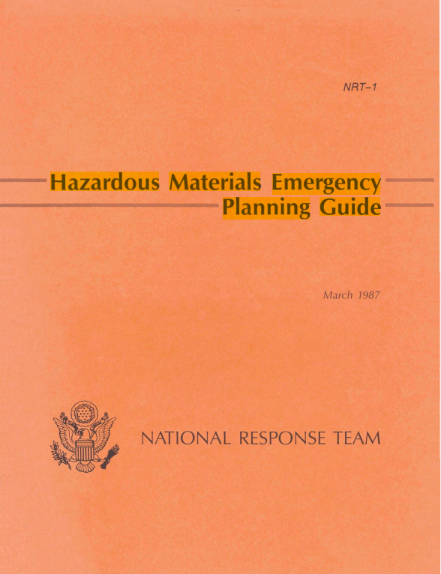
"Hazardous Materials Emergency Planning Guide" (The Orange Book: NRT-1) 1987

Slide 20
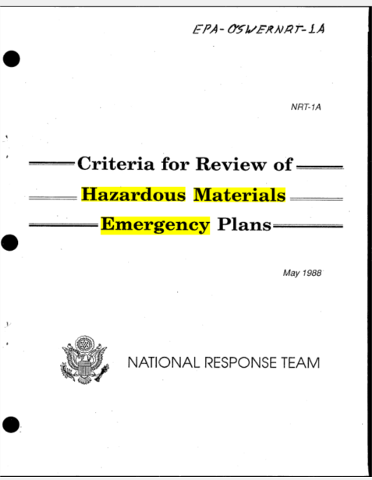
“Criteria for Review of Hazardous Materials Emergency Plans" (The Orange Book: NRT-1A) 1988

Slide 21
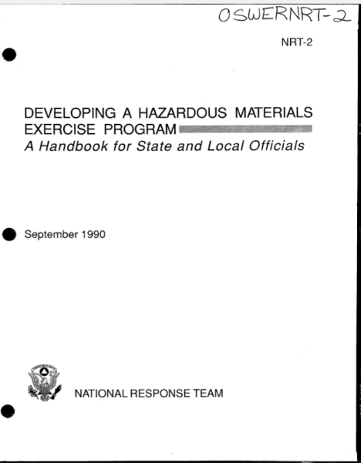
“Developing A Hazardous Materials Exercise Program" September 1990 (The Blue Book: NRT-2) 1990 EPCRA Section 303 §11003. Comprehensive emergency response plans (9) Methods and schedules for exercising the emergency plan.

Slide 22
Federal Emergency Management Agency (FEMA) Methods and schedules for exercising the emergency plan
The National Exercise Program (NEP)
The Homeland Security Exercise and Evaluation Program (HSEEP)
Consists of a nation two-year cycle of exercises across the hat examine and validate capabilities in all preparedness mission areas, guided by strategic priorities set by the National Security Council’s Principals Committee.
Provides design, development, conduct, and evaluation support for individual exercises to state, local, tribal, territorial, and other whole community partners. Coordinates exercise activities among federal interagency partners.
Provides a set of guidance that any organization can use to structure an effective exercise and evaluation program with a common approach to program management, design and development, conduct, evaluation, and improvement planning.

Slide 23
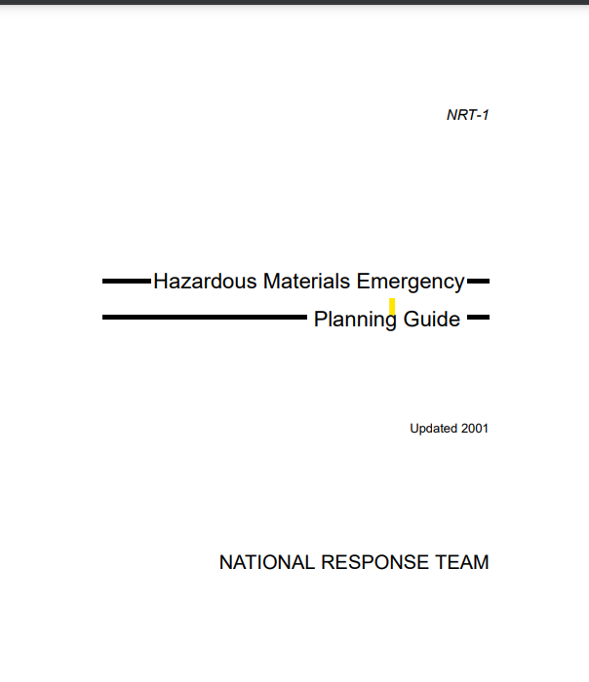
"Hazardous Materials Emergency Planning Guide" (The Orange Book: NRT-1) Updated 2001

Slide 24
FEMA Federal Emergency Management Agency https://www.fema.gov/emergency-managers/national-preparedness/plan
Accomplished properly, planning provides a methodical way to engage the whole community in thinking through the lifecycle of a potential crisis, determining required capabilities and establishing a framework for roles and responsibilities. It shapes how a community envisions and shares a desired outcome, selects effective ways to achieve it and communicates expected results.
A shared planning community increases the likelihood of integration and synchronization, makes planning cycles more efficient and effective and makes plan maintenance easier.

Slide 25
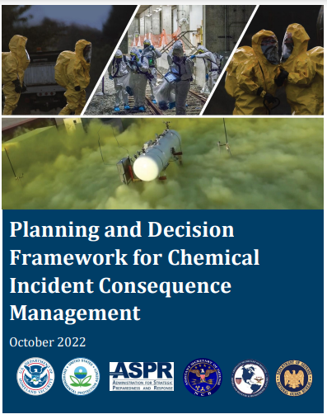

Slide 26
EPCRA Section 303 §11003. Comprehensive emergency response plans
The HMEP grant program was established in 1990 by the Hazardous Materials Transportation Uniform Safety Act. In 1993, PHMSA began issuing grants to assist States, Territories, and Native American Tribes to "develop, improve, and carry out emergency plans" within the National Response System and the Emergency Planning and Community Right-To-Know Act of 1986. The HMEP grant program is designed to allow grantees the flexibility to implement training and planning programs that address differing needs for each location based on demographics, emergency response capabilities, commodity flow studies, and hazard analysis. Relevant trainings are found in the National Fire Protection Association (NFPA) 472: Standard for Competence of Responders to Hazardous Materials/Weapons of Mass Destruction Incidents publication and the Occupational Safety and Health Administration (OSHA) regulations found in 29 CFR § 1910.120.
(8) Training programs, including schedules for training of local emergency response and medical personnel.
Hazardous Materials Emergency Preparedness (HMEP) Grant
https://www.phmsa.dot.gov/about-phmsa/working-phmsa/grants/hazmat/hazardous-materials-emergency-preparedness-hmep-grant

Slide 29
EPCRA Section 303 §11003. Comprehensive emergency response plans
(e) Review by State emergency response commission
After completion of an emergency plan under subsection (a) of this section for an emergency planning district, the local emergency planning committee shall submit a copy of the plan to the State emergency response commission of each State in which such district is located. The commission shall review the plan and make recommendations to the committee on revisions of the plan that may be necessary to ensure coordination of such plan with emergency response plans of other emergency planning districts. To the maximum extent practicable, such review shall not delay implementation of such plan.

Slide 30
EPCRA Section 303 §11003. Comprehensive emergency response plans
(g) Review of plans by regional response teams
The Regional Response Teams, as established pursuant to the National Contingency Plan as established under section 9605 of this title, may review and comment upon an emergency plan or other issues related to preparation, implementation, or exercise of such a plan upon request of a local emergency planning committee. Such review shall not delay implementation of the plan.

Slide 31
EPCRA Section 302 §11002. Substances and facilities covered and notification
(2) List of extremely hazardous substances
Within 30 days after October 17, 1986, the Administrator shall publish a list of extremely hazardous substances. The list shall be the same as the list of substances published in November 1985 by the Administrator in Appendix A of the “Chemical Emergency Preparedness Program Interim Guidance”.

Slide 32
EPCRA Section 302 List of extremely hazardous substances (EHSs)
40 CFR PART 355 - EMERGENCY PLANNING AND NOTIFICATION
List of Lists

Slide 33
CAMEO Chemicals Software https://www.epa.gov/cameo/cameo-chemicals-software

Slide 34
EPCRA Section 302 §11002. Substances and facilities covered and notification
(d) Notification of Administrator
The State emergency response commission shall notify the Administrator of facilities subject to the requirements of this subchapter by notifying the Administrator of—
(1) each notification received from a facility under subsection (c) of this section, and
(2) each facility designated by the Governor or State emergency response commission under subsection (b)(2) of this section.
(Pub. L. 99–499, title III, §302, Oct. 17, 1986, 100 Stat. 1730.)

Slide 35
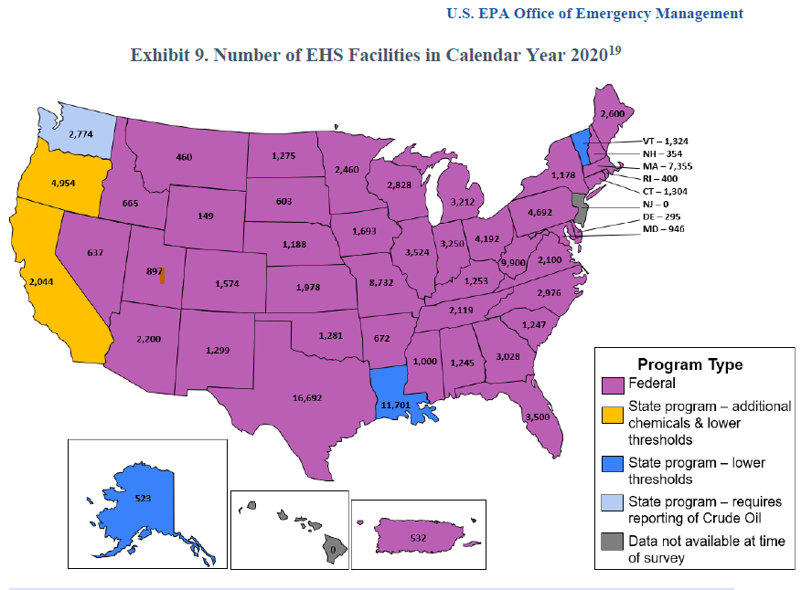

Slide 36
EPCRA Section 303 §11003. Comprehensive emergency response plans
(c) Plan provisions
Each emergency plan shall include (but is not limited to) each of the following:
(1) Identification of facilities subject to the requirements of this subchapter that are within the emergency planning district, identification of routes likely to be used for the transportation of substances on the list of extremely hazardous substances referred to in section 11002(a) of this title, and identification of additional facilities contributing or subjected to additional risk due to their proximity to facilities subject to the requirements of this subchapter, such as hospitals or natural gas facilities.

Slide 38
These guides provided the technical discussion of, and specific procedures for, a method that can be employed in conducting a hazards analysis that will allow planners to consider the potential risks in their local communities.
Green Book December 1987
Brown Book 1989 with Floppy disk drive (FDD)

Slide 39
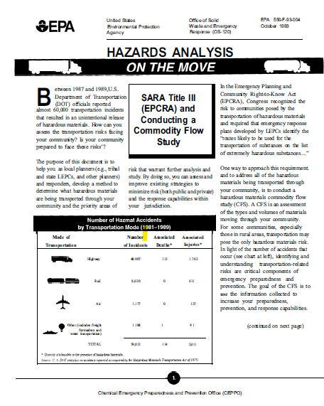

Slide 40
CAMEO Data Manager Screening & Scenarios

Slide 41
CAMEO Data Manager Screening & Scenarios

Slide 42
CAMEO Data Manager Screening & Scenarios

Slide 43
Tier2 Submit Software https://www.epa.gov/epcra/tier2-submit-software

Slide 44
Screenings & Scenario Plotting Threat Zone on a Map

Slide 45
EPCRA Section 303 §11003. Comprehensive emergency response plans
(5) Methods for determining the occurrence of a release, and the area or population likely to be affected by such release.

Slide 46
ALOHA® Software (Areal Locations of Hazardous Atmospheres) https://www.epa.gov/cameo/aloha-software

Slide 47
ALOHA® Software (Areal Locations of Hazardous Atmospheres) https://www.epa.gov/cameo/aloha-software

Slide 48
EPCRA Section 303 §11003. Comprehensive emergency response plans
(2) Methods and procedures to be followed by facility owners and operators and local emergency and medical personnel to respond to any release of such substances.
Occupational Safety and Health Administration (OSHA)
The Hazard Communication Standard (HCS)
(29 CFR 1910.1200(g)), revised in 2012, requires
that the chemical manufacturer, distributor,
or importer provide Safety Data Sheets
(SDSs) (formerly MSDSs or Material Safety
Data Sheets) for each hazardous chemical
to downstream users to communicate
information on these hazards

Slide 49
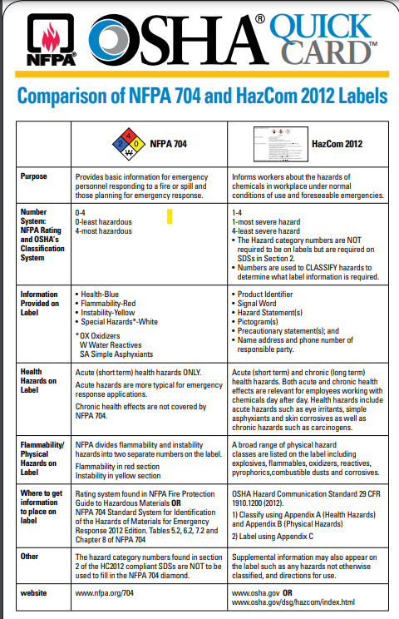

Slide 50
The Integrated Contingency Plan (ICP), also referred to as "One Plan" guidance, is a resource for consolidating numerous regulations and multiple emergency response plans concerning releases of oil and nonradiological hazardous substances into one functional plan. June 5, 1996 Based on National Incident Management System
https://www.govinfo.gov/content/pkg/FR-1996-06-05/pdf/96-13712.pdf
https://www.fema.gov/pdf/library/bizindst.pdf

Slide 51
EPCRA Section 303 §11003. Comprehensive emergency response plans
(6) A description of emergency equipment and facilities in the community and at each facility in the community subject to the requirements of this subchapter, and an identification of the persons responsible for such equipment and facilities.

Slide 52
EPCRA Section 303 §11003. Comprehensive emergency response plans
(4) Procedures providing reliable, effective, and timely notification by the facility emergency coordinators and the community emergency coordinator to persons designated in the emergency plan, and to the public, that a release has occurred (consistent with the emergency notification requirements of section 11004 of this title).
Emergency vehicle bull horn loud speaker and siren
Reverse 9-1-1
Wireless Emergency Alerts (WEAs)
FEMA’s Integrated Public Alert and Warning System (IPAWS)
Emergency Alert System (EAS)
Commercial Mobile Alert System (CMAS).
Non-Weather Emergency Messages (NWEM).
Social Media

Slide 53
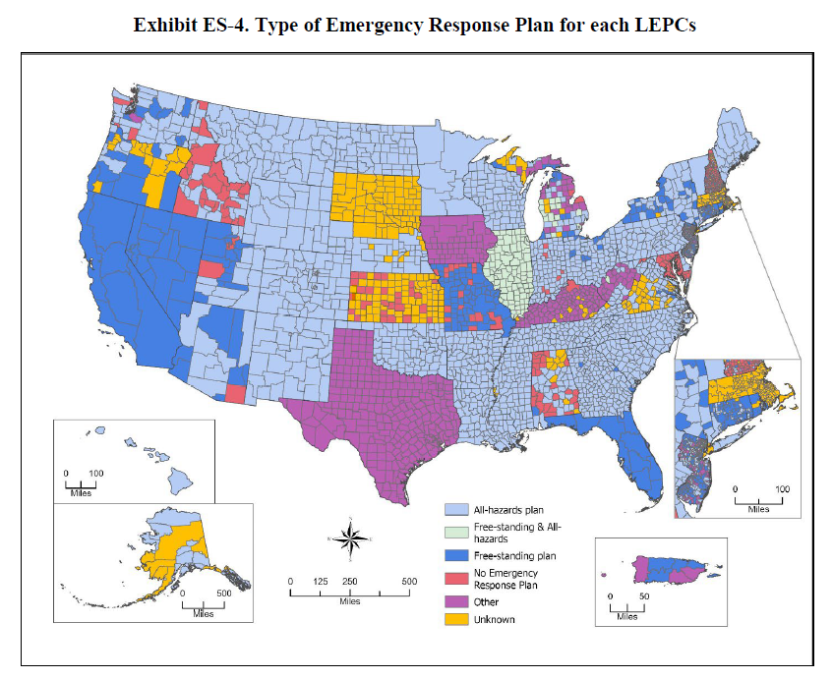

Slide 54
EPCRA Section 304 §11004. Emergency notification
PART 355 - EMERGENCY PLANNING AND NOTIFICATION
PART 302 - DESIGNATION, REPORTABLE QUANTITIES, AND NOTIFICATION
Reporting Requirements for Continuous Releases of Hazardous Substances, A Guide for Facilities on Compliance
https://www.epa.gov/epcra/reporting-requirements-continuous-releases-hazardous-substances-guide-facilities-compliance#:~:text=The%20Continuous%20Release%20Rule%20provides,stable%20in%20quantity%20and%20rate.

Slide 55
Where to Submit Continuous Release Reports for Releases of CERCLA Hazardous Substances and EPCRA Extremely Hazardous Substances

Slide 56
Amendments to EPCRA Section 304 Section 2018 of the America’s Water Infrastructure Act (AWIA), enacted on October 23, 2018

Slide 57
US Chemical Safety and Hazard Investigation Board (CSB)
The US Chemical Safety and Hazard Investigation Board (CSB) accidental release reporting rule that took effect in March 2020.
CSB’s release reporting rule requires owners/operators of stationary sources to make a report to CSB within 8 hours of an accidental release to the air of a regulated substance or extremely hazardous substance that results in death, serious injury, or substantial property damage
40 CFR PART 1604 - REPORTING OF ACCIDENTAL RELEASES

Slide 58
EPCRA Section 311 and 312 §11021. Material safety data sheets and §11022. Emergency and hazardous chemical inventory forms
OSHA's Hazard Communication Standard (HCS) 29 CFR 1910.1200
June 1, 2016
Hazard classification: Provides specific criteria for classification of health and physical hazards, as well as classification of mixtures.
Labels: Chemical manufacturers and importers will be required to provide a label that includes a harmonized signal word, pictogram, and hazard statement for each hazard class and category. Precautionary statements must also be provided.
Safety Data Sheets: Will now have a specified 16-section format.
Information and training: Employers are required to train workers on the new labels elements and safety data sheets format to facilitate recognition and understanding.
Amendments to EPCRA Section 312
Section 2018 of the America’s Water Infrastructure Act (AWIA) October 23, 2018, also amended EPCRA Section 312, requiring SERCs, TERCs, LEPCs, and TEPCs to provide affected community water systems with Tier II information for facilities within their source water area upon request. Source water areas may span multiple jurisdictional boundaries at the state, tribal, and local levels, potentially requiring access to Tier II information from multiple SERCs, TERCs, LEPCs, or TEPCs. If a facility has not complied with Tier II reporting requirements, then the SERC (or TERC) and LEPC (or TEPC) should request that the facility submit its Tier II form and then provide Tier II information to the affected community water systems.

Slide 59
EPCRA Section 312 §11022. Emergency and hazardous chemical inventory forms
(a) Basic requirement
(1) The owner or operator of any facility which is required to prepare or have available a material safety data sheet for a hazardous chemical under the Occupational Safety and Health Act of 1970 [29 U.S.C. 651 et seq.] and regulations promulgated under that Act shall prepare and submit an emergency and hazardous chemical inventory form (hereafter in this chapter referred to as an “inventory form”) to each of the following:
(A) The appropriate local emergency planning committee.
(B) The State emergency response commission.
(C) The fire department with jurisdiction over the facility.

Slide 60
Tier2 Submit Software Since 1999
https://www.epa.gov/epcra/tier2-submit-software
https://www.epa.gov/cameo/cameo-data-manager-software

Slide 61
CAMEO Data Manager Software

Slide 62
Tier2 Submit Software

Slide 63
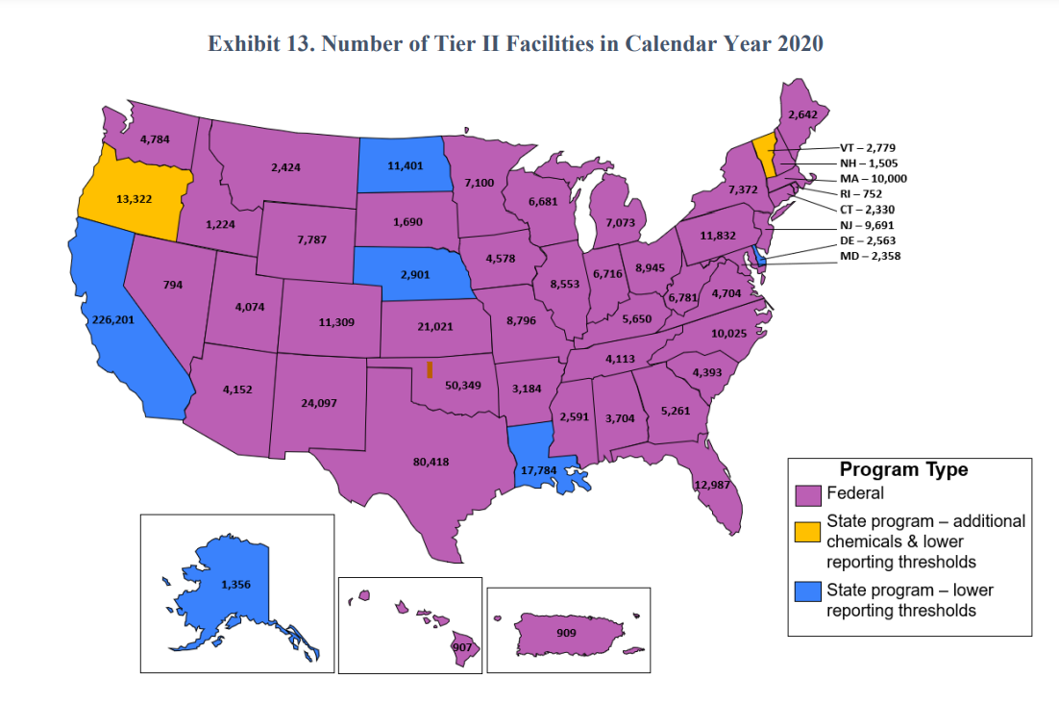

Slide 64
Tier2 Submit Software and CAMEO Data Manager

Slide 65
Tier2 Submit Software and CAMEO Data Manager

Slide 66
Qlik
Qlik closes the gaps between data, insights and action with the only cloud platform built for Active Intelligence. Make your data and analytics real-time, AI-driven, collaborative and actionable.

Slide 67
§11044. Public availability of plans, data sheets, forms, and follow up notices
(b) Notice of public availability
Each local emergency planning committee shall annually publish a notice in local newspapers that the emergency response plan, material safety data sheets, and inventory forms have been submitted under this section. The notice shall state that follow up emergency notices may subsequently be issued. Such notice shall announce that members of the public who wish to review any such plan, sheet, form, or follow up notice may do so at the location designated under subsection (a) of this section.

Slide 68
EPA Region 1 Video Series on EPCRA and CAA RMP/GDC
1. Introduction to Facility Hazards and Chemical Safety
2. EPCRA Sections 301-303: Emergency Planning with your SERC/TERC/LEPC/TEPC
3. EPCRA Section 304: Reporting Accidents and Continuous Releases
4. EPCRA Sections 311-312: Tier II Reporting and Tier2 Submit Software
Watch on YouTube: https://www.youtube.com/playlist?list=PLvC8kUCteU1_N54sCAD6b-dsE2ocYybws
68

Slide 69
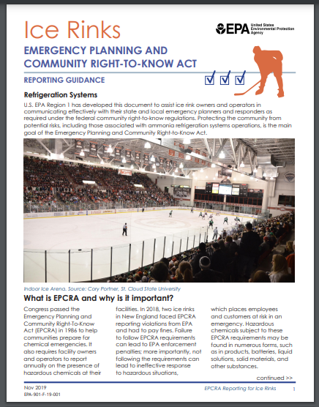
EPCRA Reporting for Ice Rinks
EPCRA Reporting Guidance for Ice Rinks Fact sheet, November 2019
https://www.epa.gov/sites/default/files/2019-11/documents/epcra_ice_rink_ammoniafs6.pdf
Remember: the deadline to submit EPCRA Tier 2 is March 1st of every year.

Slide 70
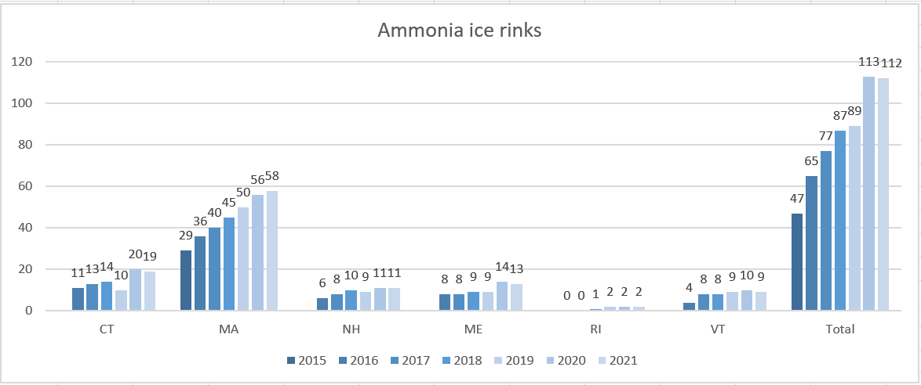

Slide 72
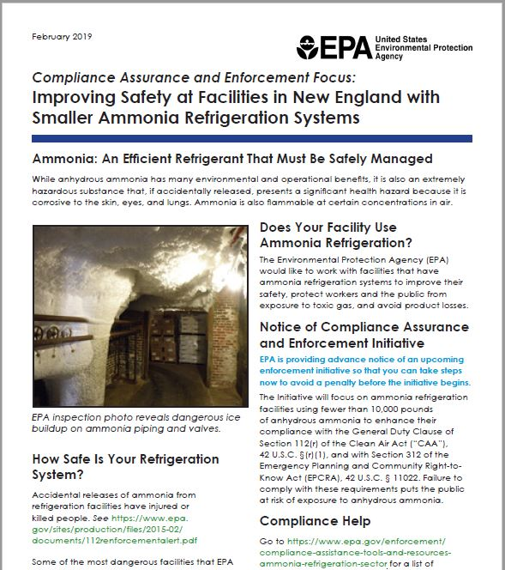
Impact of GDC Pilot
Resource limitations mean:
No EPA review of process hazard reviews (not even submitted)
Settlement only resolves one GDC count
May not reach entire ammonia refrigeration universe
But Pilot should:
Reach more facilities
Raise companies’ awareness of hazards posed by their systems
Improve GDC and EPCRA compliance
Increase safety of communities and emergency responders
Notes:
Take out?

Slide 73
Impact of GDC Pilot

Slide 74
Chemical Facility Security and Safety Working Group Executive Order 13650: Improving Chemical Facility Safety and Security https://www.osha.gov/chemical-executive-order/history

Slide 75
Region 1 Chemical Facility Security and Safety Working Group
Contact Us with any Further Questions
Charles I. Colley, Chief
Chemical Security New England R-I
Office of Chemical Security
DHS
Cybersecurity and Infrastructure Security Agency
202.302.6367 M
617.565.2919 O
charles.colley@dhs.sgov.gov
Gabriel Porter, Assistant Area Director
US Dept. of Labor
Occupational Safety and Health Administration
Direct (603) 225-1645
Office (603) 225-1629 Fax. (603) 225-1580
porter.gabriel@dol.gov

Slide 76
Chemical Warehouse and Distribution Facilities
New National Alerts

Slide 77
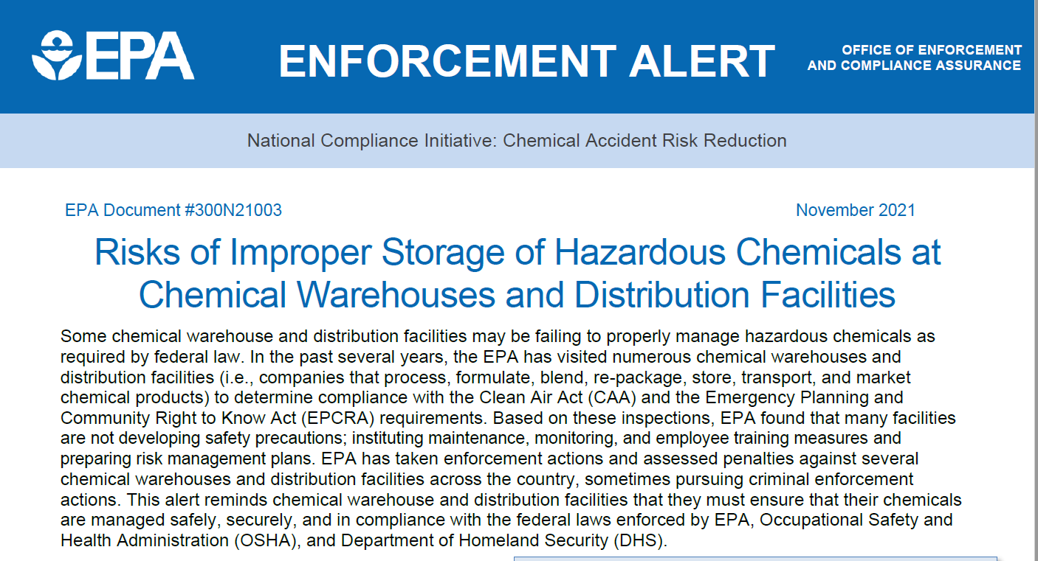
Enforcement
Serious deficiencies found on several Region 1 inspections
Need a way to improve safety
Owners are likely to improve the safety of their facilities once they recognize the hazards at their facility
https://www.epa.gov/system/files/documents/2021-11/chemicalwarehouseenforcementalert_0.pdf

Slide 78
Multi Agency Safety Advisory
https://www.epa.gov/system/files/documents/2021-11/11_02_21_jointsafteyaltert_chemicalwarehouse_final.pdf

Slide 79
EPA eDisclosure
Web based “eDisclosure” portal launched December 2015
Allows entities to promptly disclose violations and submit compliance certification under EPA’s Audit policy
eDisclosure: https://www.epa.gov/compliance/epas-edisclosure
EPA Audit Policy: https://www.epa.gov/compliance/epas-audit-policy
79

